Slide 1
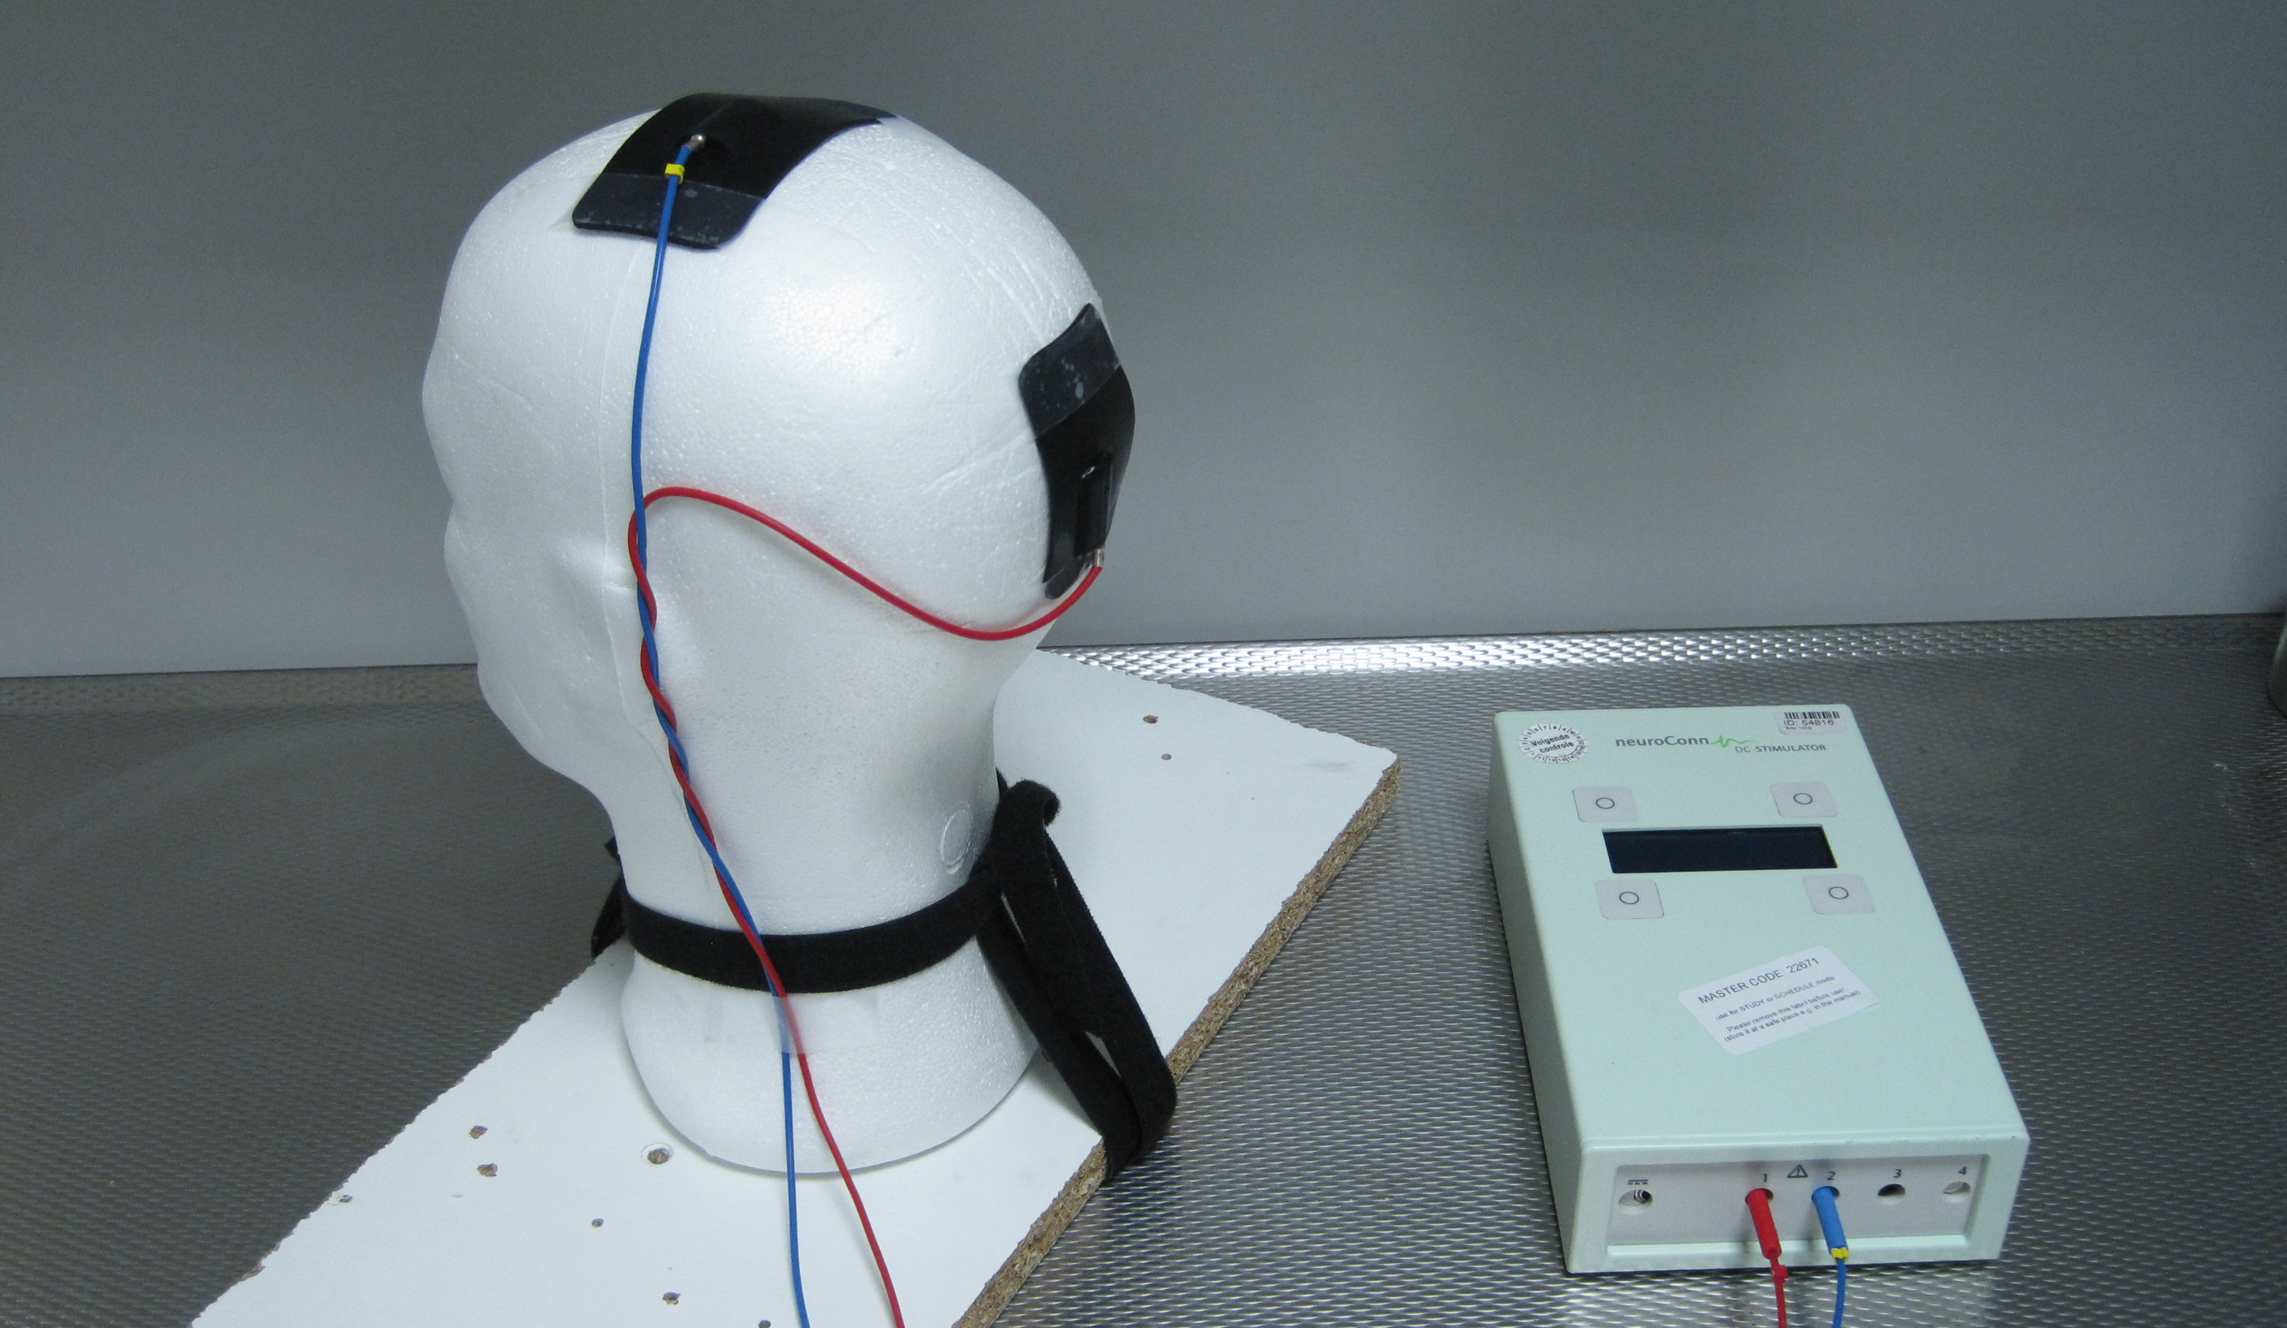

tES: Study Design
Introduction to Brain Stimulation 2018
CUBRIC, Cardiff University

Slide 2
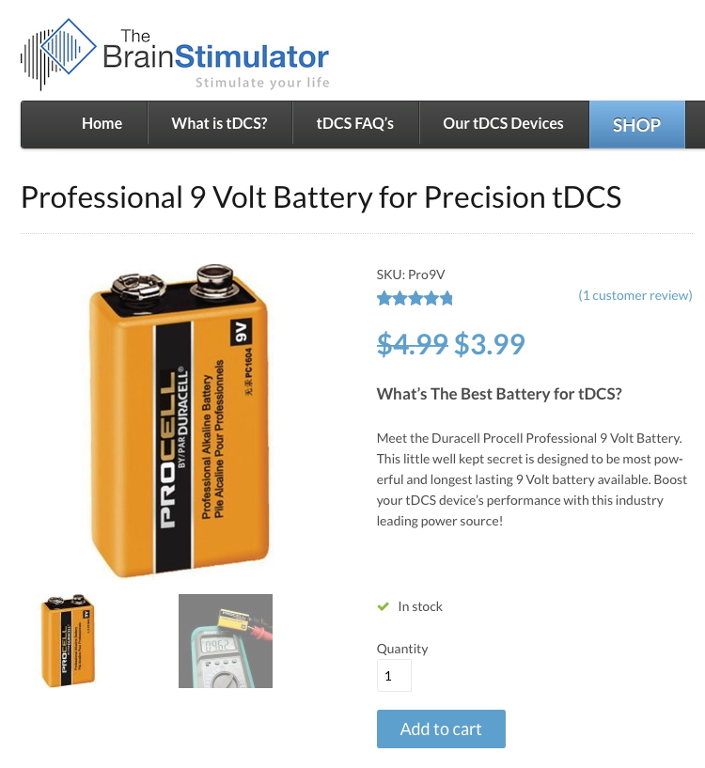
What do I need for a good tES study?
A clear idea of...
Strengths and limitations of tES
Experimental parameters
Safety concerns
Notes:
Batsikadze, G., Moliadze, V., Paulus, W., Kuo, M.-F., & Nitsche, M. A. (2013). Partially non-linear stimulation intensity-dependent effects of direct current stimulation on motor cortex excitability in humans. The Journal of Physiology, 591(Pt 7), 1987e2000.

Slide 3
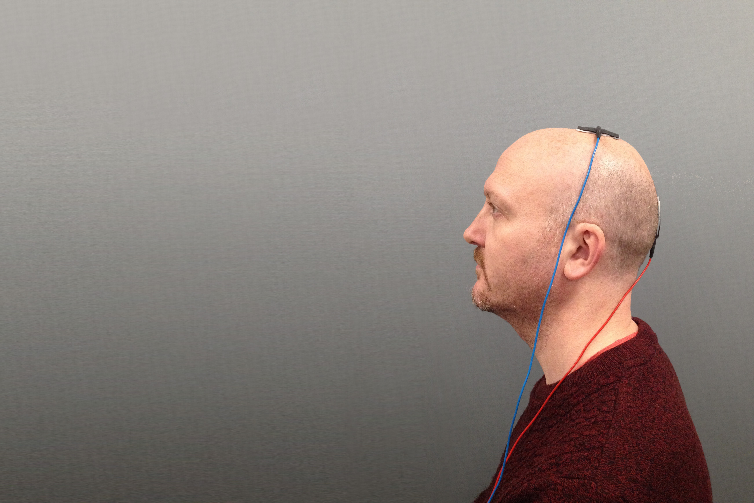

Study design and stimulation parameters
Stimulation parameters
Waveform (tDCS, tACS, tRNS)
Electrode montage
Current density
Timing & duration
Within- vs. between-subjects design
Control condition
Blinding
Safety and CUBRIC Standard Operating Procedure
Notes:
And, to me, the long term goal in all of this is to develop dose-dependent approaches to tES:
So imagine a patient who has had stroke comes in and based on some key characteristics,
the clinician can then develop a stimulation protocol that will optimally support this patient’s brain in rehabilitation

Slide 4
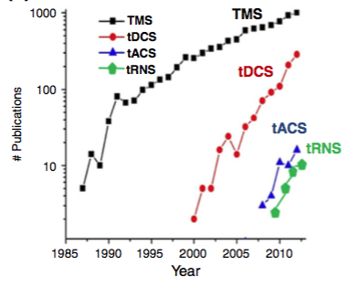
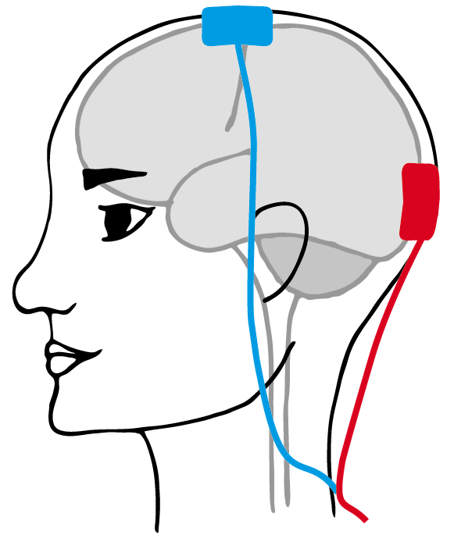
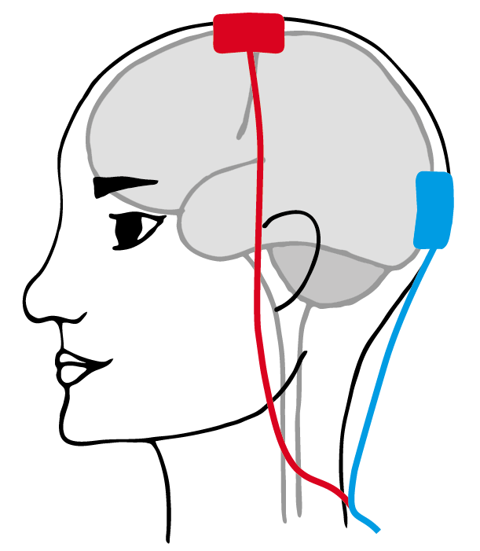
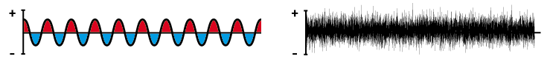
Stimulation waveform
Direct vs. alternating current “shapes”
tDCS
anodal
cathodal
sham
tACS
tRNS
Notes:
tACS: Usually motivated by a desire to use discrete frequencies to ‘entrain’ or ‘modulate’ ongoing cortical rhythms. Particularly useful if paired with EEG and/or MEG to allow empirical detection of subject specific rhythms. But for some multimodal combos: need to somehow separate intrinsic oscillations from artefacts caused by the stimulation itself...
tRNS: Uses a random noise frequency pattern to potentially ‘desynchronize’ pathological rhythms (0.1-640Hz). NOT ‘random’ per se: normally distributed levels of current, randomly selected (1280 samples/s).
Mechanisms? Difficult to isolate, but probably focusing on the repeated opening of Na⁺ channels.

Slide 5
Timing: Online vs. offline paradigms
Stimulation before vs. during measurement
Consider different physiological mechanisms for online vs. offline (→ Stagg et al., 2011; → Hone-Blanchet et al., 2016)
measurements
Online
Modulating level of acute cortical excitability
stimulation
block(s) of several seconds to many minutes
Offline
Inducing plasticity to facilitate or inhibit cortical excitability
measurements
stimulation
block of 5, 10, 20+ minutes
”after-effects”

Slide 6
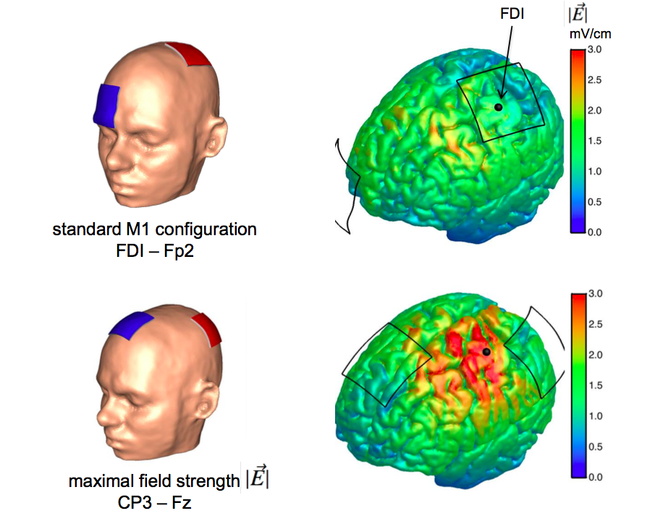
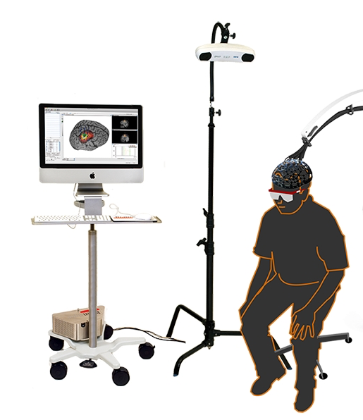
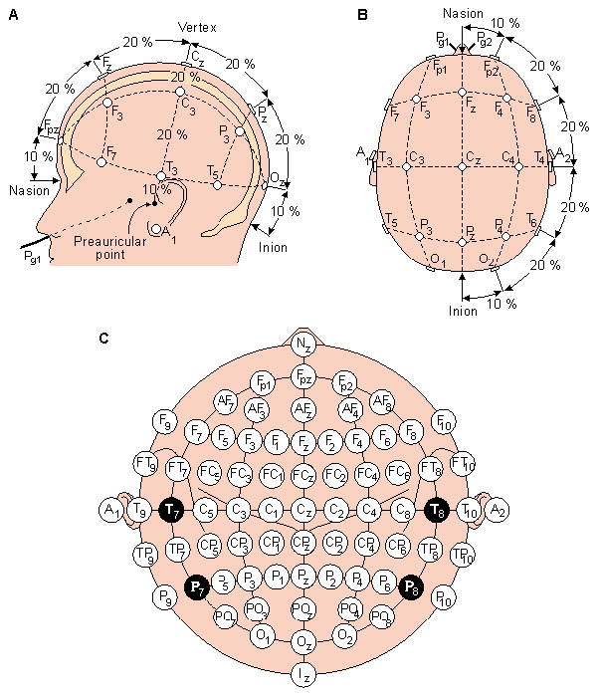
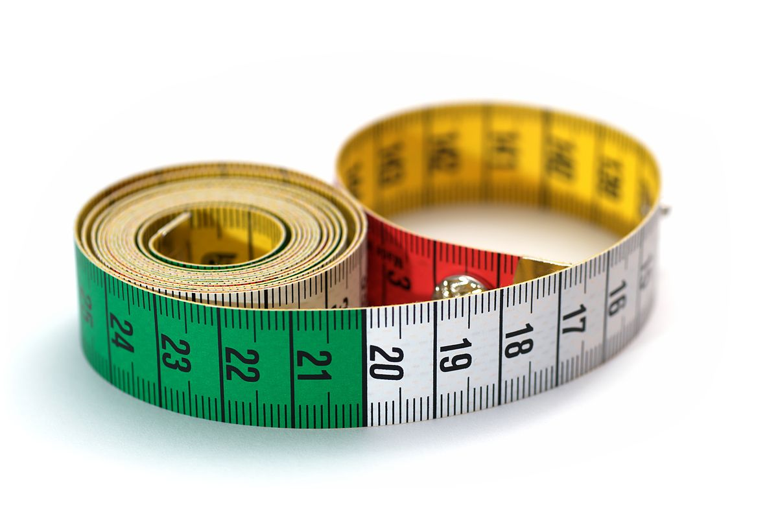
Electrode montage
Electrode locations for optimal targeting of your ROI
Electrode placement in practice
Neuronavigation
MRI + Brainsight
International EEG system
Nz-Iz, LPA-RPA, circumference

Slide 7
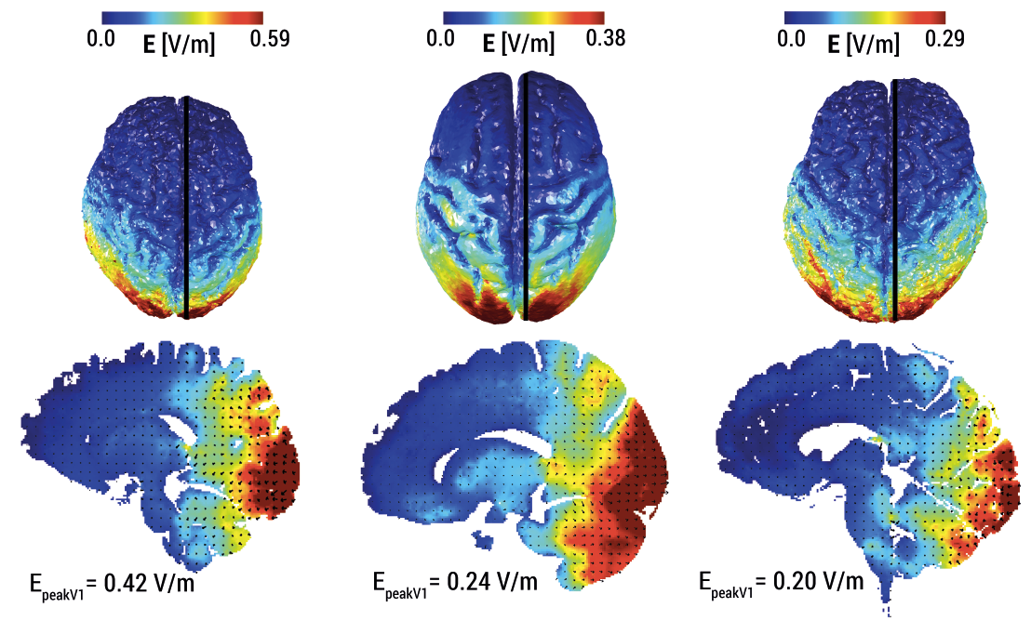
Current density
Current density (A/m²) typically 1.0-2.0 mA via 25-50 cm²
Consider potential non-linear effects (→ Batsikadze et al., 2013; → Ammann et al., 2017)
Consider current density for skin vs. brain (→ Laakso et al., 2015; → Bikson et al., 2016)
Example: tDCS-induced electric field in V1
1.5 mA via 25 cm² electrode = 0.6 A/m² current density at scalp
Subject 1
Subject 2
Subject 3
Notes:
Electric field (in V/m) is current density multiplied by local tissue resistivity.
The current density in skin is thus invariably higher than in the brain.
The skin to brain ratio varies from greater than 10:1 to 400:1
injury threshold levels in animals 6.3– 17 A/m2
Peak current densities in the modeling literature (spanning heads, model parameterization and tDCS dose) range from 0.0828 to 0.211 A/m2
predicted minimum induced current density for brain lesions were 12, 17, 6.3 A/m2 (corresponding to electric fields of 42, 61, to 23 V/m)
Typical human tDCS driven by 2 mA at the electrodes resulted in 0.096 A/m2 (0.35 V/m) on the cortex.
2 mA through 5x5 cm = 0.8 A / m²

Slide 8
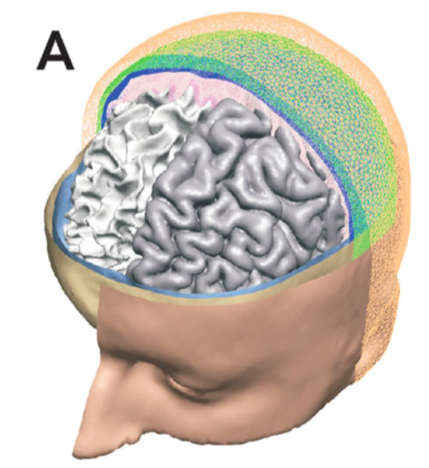
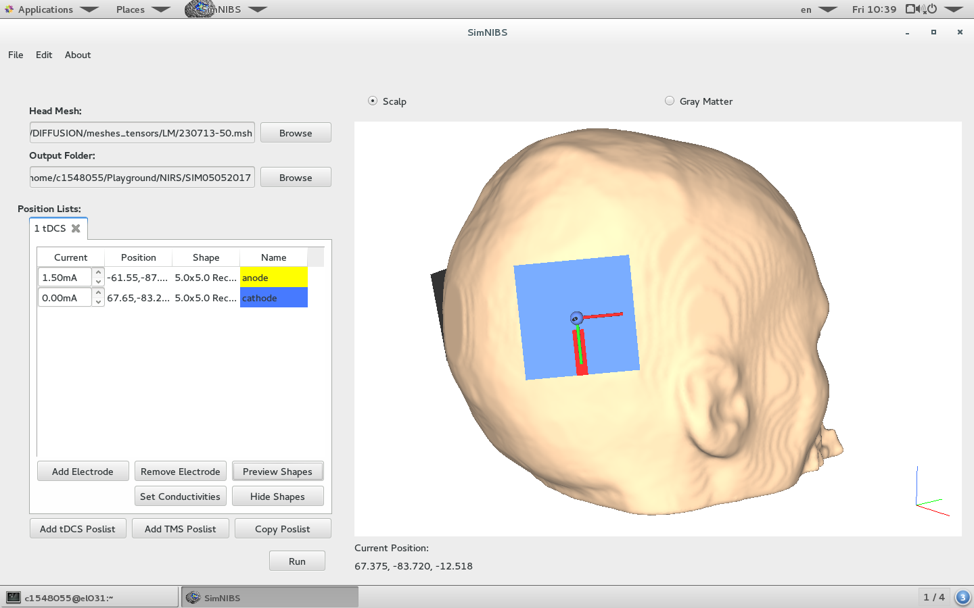
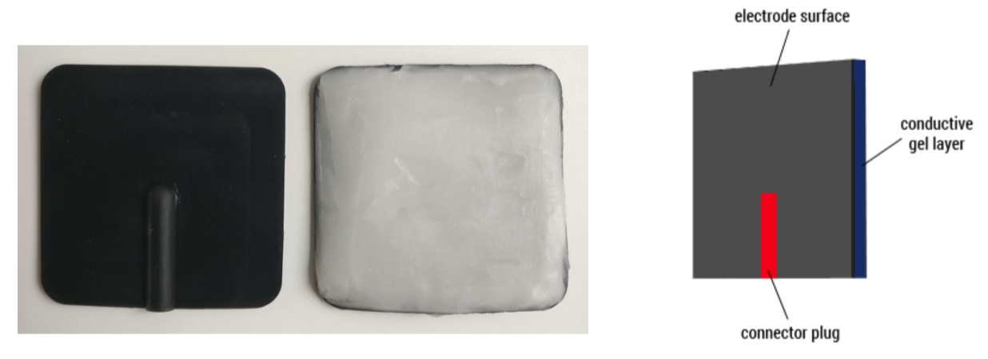
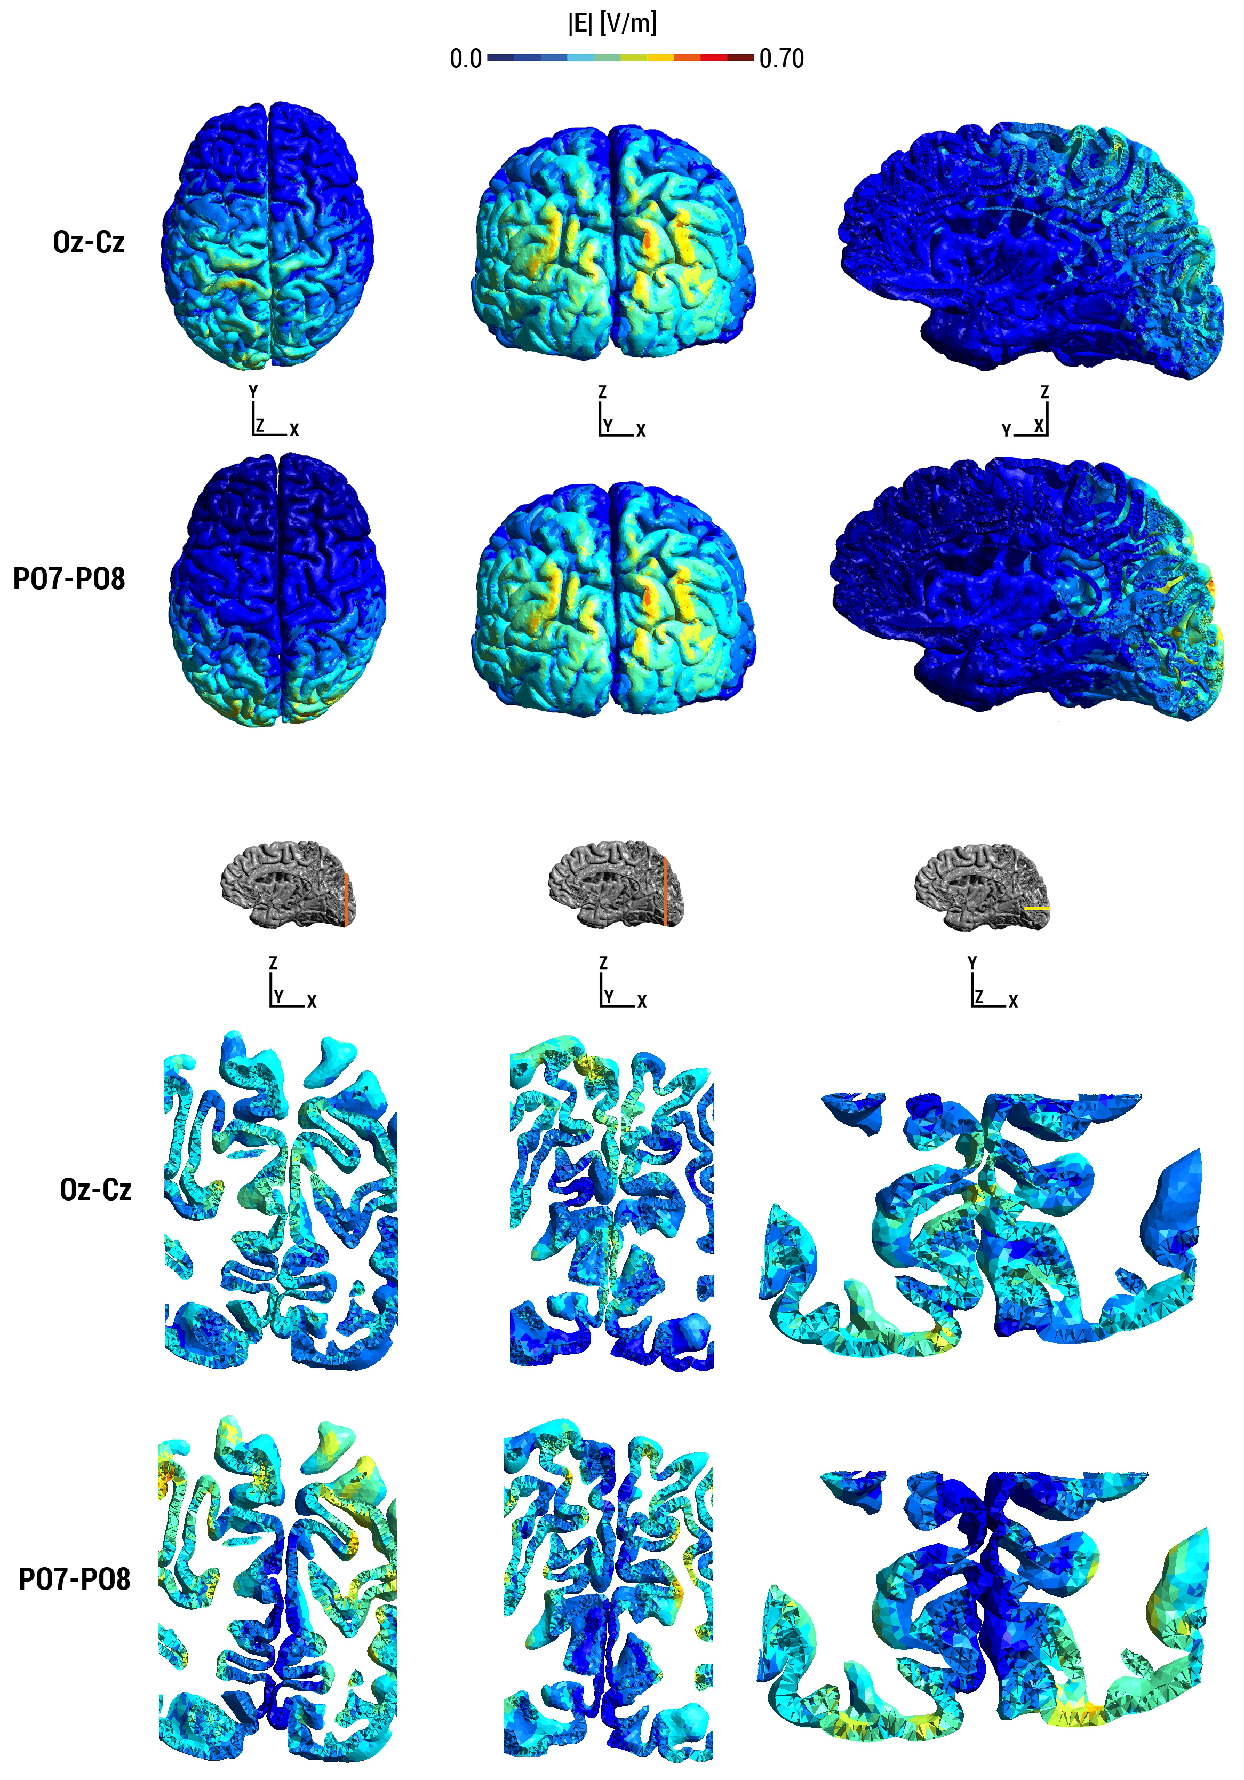
Modelling tES-induced electric fields
Anatomical MRI
T1- and T2-weighted
Tissue segmentation
FreeSurfer/FSL or SPM
FEM model
SimNIBS or ROAST
Electric field distribution
Subject-specific field strength and direction
Is the electric field focused in my ROI?
Input current intensity vs. intensity in ROI?

Slide 9
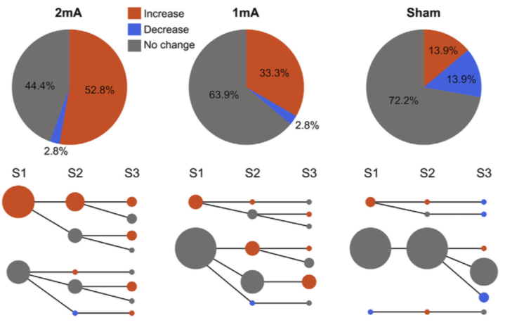
Within- vs. between-subjects design
Consider intra- vs. interindividual variance in your paradigm (→ Chew et al., 2015; → Li et al., 2015)
Consider control condition/group (→ Davis et al., 2013)
Consider sample size
Example: post-tDCS responses across three sessions of M1 stimulation
Ammann et al. 2017
Notes:
Fig. 5. Pie charts of post-tDCS responses across sessions classified with the Sham Variability-Based Threshold. A) Responses were classified as ‘increase’ (>1.3), ‘no change’ (0.7 < ratio < 1.3) and ‘decrease’ (<0.7). B) Individual response tracking across sessions for each condition. Same classification scheme as in A but separated by session. Dot sizes are linearly proportional to the number of subjects (n 1⁄4 12). The biggest dot size represents 9 subjects and the smallest dot size represents 1 subject.
2 mA-atDCS induces a more consistent group excitatory response than 1 mA-atDCS across repeated sessions when applied with at least 48 h apart

Slide 10

Blinding
Sham tES
Compare real tES to a no-stimulation baseline (with comparable sensory input).
Participant blinding
Slow ramping to reduce skin sensations (real and sham tES)
Low impedance to reduce skin sensations (real and sham tES)
Naïve participants (experienced subjects guess more accurately)
Additional factors specific to tES type (e.g. phosphenes)
Experimenter blinding
Study mode (use tES device in double-blind mode)
Skin redness (consider in your lab protocol)
Assess blinding quality with questionnaires!
e.g. Fertonani et al. (2015)
Notes:
Establish the effect of real tES by comparing it to a no-stimulation baseline (with comparable sensory input).

Slide 11
Control conditions
What to control for?
Spatial specificity tES of region A but not B affects outcome variable
Temporal specificity tES during period A but not B affects outcome variable
Functional specificity tES affects task A but not B
Protocol specificity
Polarity
Intensity
Frequency (tACS only)
Phase (tACS only)
Notes:
polarity specificity: e.g., opposite effects of anodal and cathodal tDCS - frequency-specificity: e.g., 10 Hz but not 15 Hz affects visuospatial attention - phase-specificity: e.g., detection performance depends on 10 Hz phase angle - amplitude-specificity: e.g., 1 mA but not 0.5 mA tACS has an effect

Slide 12
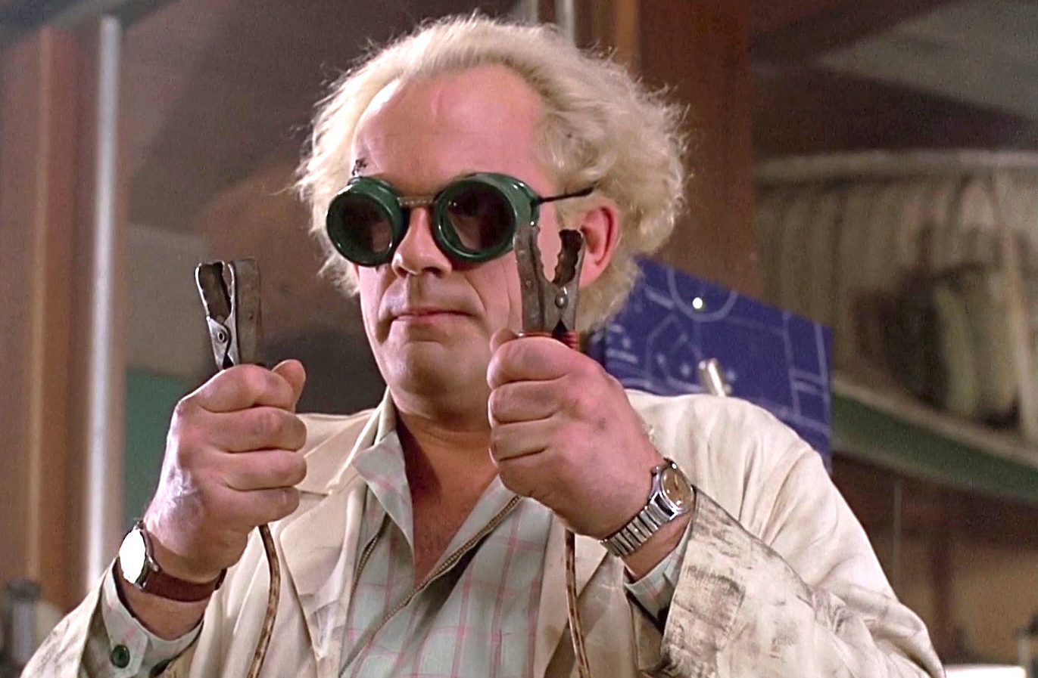
Safety
Don’t try this at home the lab....

Slide 13
Safety
CUBRIC SOP
We have an established standard operating procedure for tES experiments at CUBRIC. ➜ Ask Sophie or Adam!
We have a “quick start” manual for the NeuroConn DC stimulator devices. ➜ Ask Sophie or Dave
Literature
Bikson et al. (2016). Safety of Transcranial Direct Current Stimulation: Evidence Based Update 2016. Brain Stimulation, 9(5)
Paneri et al. (2016). Tolerability of Repeated Application of Transcranial Electrical Stimulation with Limited Outputs to Healthy Subjects. Brain Stimulation, 9(5), 740–754.

Slide 14
Literature
Good technical overview:
Woods, A. J., Antal, A., Bikson, M., Boggio, P. S., Brunoni, A. R., Celnik, P., et al. (2016). A technical guide to tDCS, and related non-invasive brain stimulation tools. Clinical Neurophysiology, 127(2), 1031–1048.
Ammann, C., Lindquist, M. A., & Celnik, P. A. (2017). Response variability of different anodal transcranial direct current stimulation intensities across multiple sessions. Brain Stimulation, 10(4), 757–763.
Batsikadze, G., Moliadze, V., Paulus, W., Kuo, M.-F., & Nitsche, M. A. (2013). Partially non-linear stimulation intensity-dependent effects of direct current stimulation on motor cortex excitability in humans. The Journal of Physiology, 591(Pt 7), 1987e2000.
Chew, T., Ho, K.-A., & Loo, C. K. (2015). Inter- and Intra-individual Variability in Response to Transcranial Direct Current Stimulation (tDCS) at Varying Current Intensities. Brain Stimulation, 8(6), 1130–1137.
Davis, N. J., Gold, E., Pascual-Leone, A., & Bracewell, R. M. (2013). Challenges of proper placebo control for non-invasive brain stimulation in clinical and experimental applications. European Journal of Neuroscience, 5(7), n/a–n/a.
Fertonani, A., Ferrari, C., & Miniussi, C. (2015). What do you feel if I apply transcranial electric stimulation? Safety, sensations and secondary induced effects. Clinical Neurophysiology, 126(11), 2181–2188.
Hone-Blanchet, A., Edden, R. A., & Fecteau, S. (2016). Online Effects of Transcranial Direct Current Stimulation in Real Time on Human Prefrontal and Striatal Metabolites. Biological Psychiatry, 1–7.
Laakso, I., Tanaka, S., Koyama, S., De Santis, V., & Hirata, A. (2015). Inter-subject Variability in Electric Fields of Motor Cortical tDCS. Brain Stimulation, 8(5), 906–913.
Li, L. M., Uehara, K., & Hanakawa, T. (2015). The contribution of interindividual factors to variability of response in transcranial direct current stimulation studies. Frontiers in Cellular Neuroscience, 9(180), 181–19. http://doi.org/10.3389/fncel.2015.00181
Stagg, C. J., Jayaram, G., Pastor, D., Kincses, Z. T., Matthews, P. M., & Johansen-Berg, H. (2011). Polarity and timing-dependent effects of transcranial direct current stimulation in explicit motor learning. Neuropsychologia, 49(5), 800–804.
More questions? EstererS@cardiff.ac.uk

